Slide 1
Decision Trees

Slide 2
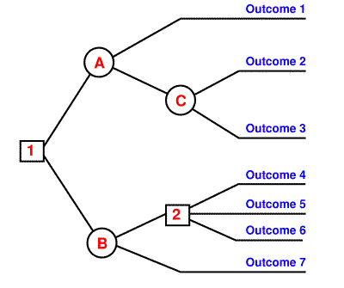
Decision Tree
An algorithm for classification that makes decisions by splitting up the training set based on specific features
When trying to decide how to classify an example, we will ask a series of questions (often yes/no questions)
Which questions we ask will depend on what the training set looks like

Slide 3
Decision Tree
By splitting up the possible outcomes at each question, we create a diagram that looks like a family tree
We call this a rule-based classifier because at each step, we follow a specific rule to make a decision
Decision trees make it very clear how we ended up at a certain conclusion because we can trace which questions we asked along the way

Slide 4
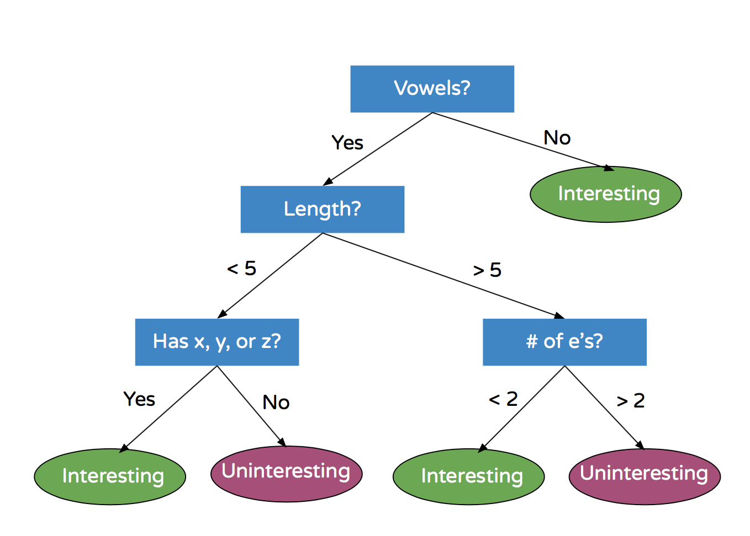
Example
How would we classify the following words according to this decision tree?
Rhythm
Abibliophobia
Emergence
Zen

Slide 5
Summary
A decision tree is a simple and fast way to do classification based on asking questions about one feature at a time
Very easy to understand why certain decisions are made
Easy to follow how the algorithm makes its classification decisions (not the case for more complex algorithms!)
Built by identifying “best splits” in the training data

Slide 6

Tuning

Slide 7
What is tuning in ML?
Tuning is the process of maximizing a model’s performance without overfitting or creating too high of a variance.
In machine learning, this is accomplished by selecting appropriate “hyperparameters.”
Choosing an appropriate set of hyperparameters is crucial for model accuracy, but can be computationally challenging. Hyperparameters are not learned by the model automatically through training methods. Instead, these parameters must be set manually.

Slide 8
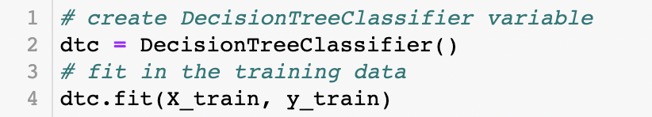
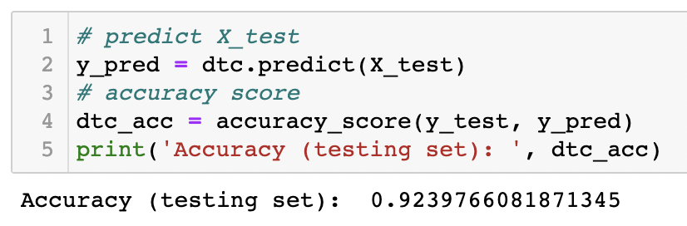
Let’s take Decision Tree as an example
Classical way to build a model:
Import the algorithm
Fit data
Predict data
Check for accuracy

Slide 9
Let’s take Decision Tree as an example
Classical way to build a model:
Import the algorithm
Fit data
Predict data
Check for accuracy
But there is a way to improve the results!

Slide 10
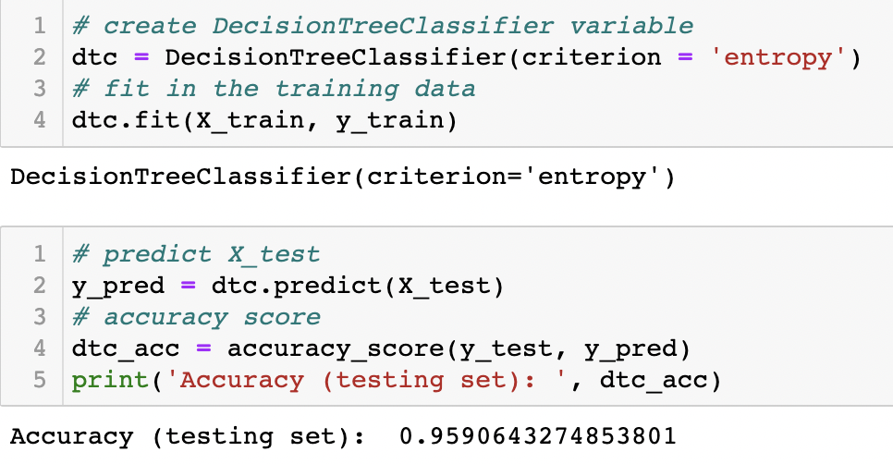
Let’s modify our code a little!
We added (criterion = 'entropy’) as a hyperparameter, and our accuracy improved!

Slide 11
Let’s take Decision Tree as an example
We added (criterion = 'entropy’) as a hyperparameter, and our accuracy improved!

Slide 12
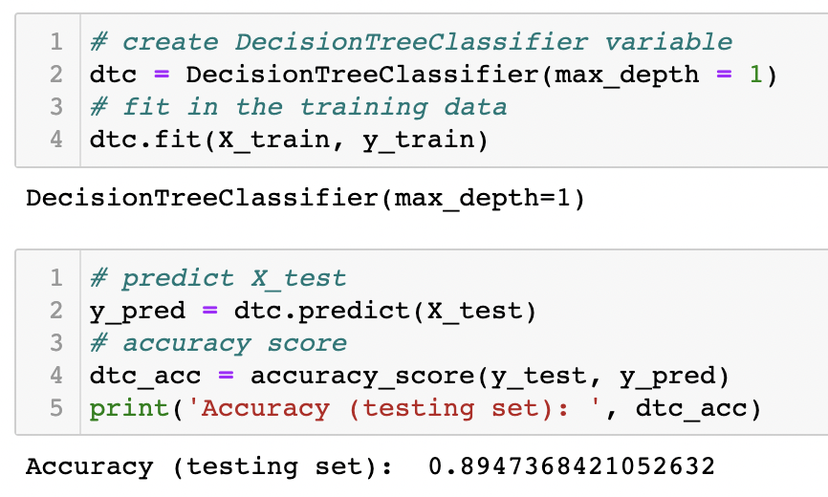
Let’s try more!
Unfortunately, not all changes in hyperparameters give us better results

Slide 13

Important questions
Where do we get these hyperparameters from?
What if I don’t set any hyperparameters?
How do I find the best hyperparameters?

Slide 14
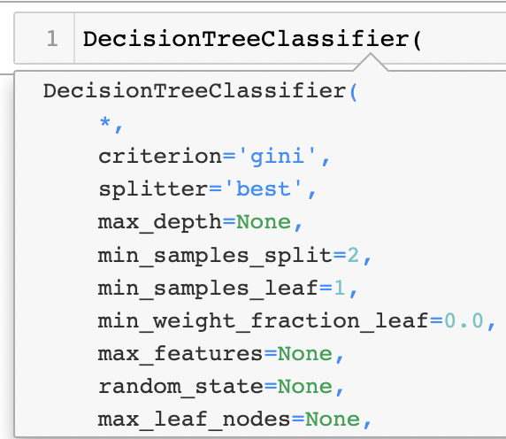
1. How to find hyperparameters of the DecisionTreeClassifier
Short cut (shift + tab)

Slide 15
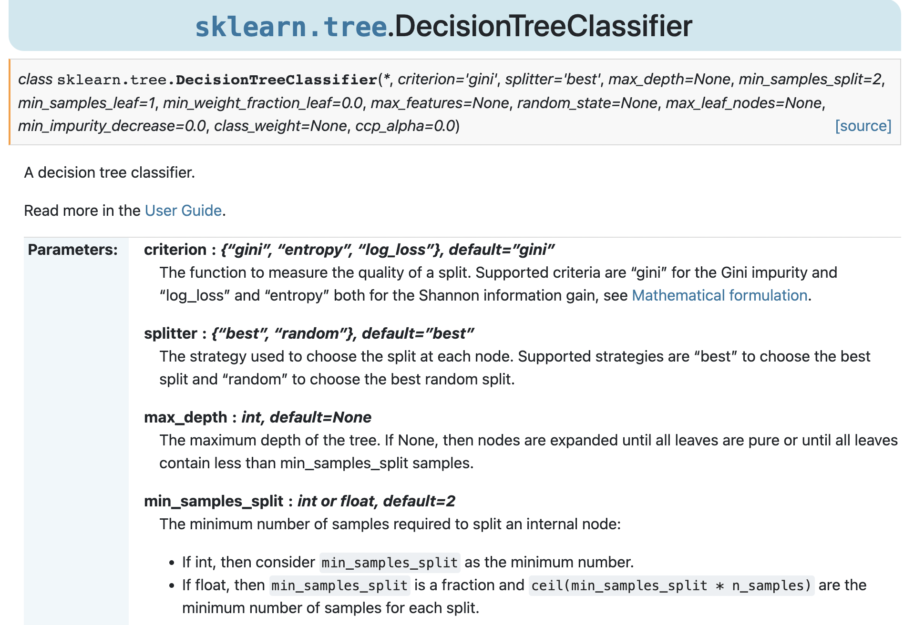
1. How to find hyperparameters of the DecisionTreeClassifier
Short cut (shift + tab)
Google documentation for functions

Slide 16
2. If you don’t set any hyperparameters…
just have a closer look at the documentation :
All of the hyperparameters are already tuned by default
Even if you don’t set any parameters, they’ve been set for you from before

Slide 17
3. How to find the best hyperparameters?
You definitely don’t have to do it manually!
Many methods/algorithms exist for selecting appropriate hyperparameters.
Grid Search
Random Search
Bayesian Optimization

Slide 18
Grid Search

Slide 19
Main logic behind the Grid Search:
sets up a grid of hyperparameter values
for each combination, train a model and score on the validation data
in this approach, every single combination of hyperparameters values is tried

Slide 20
To use Grid Search for our project, we need to
Select parameters and their ranges
Choose our model
Import/create GridSearchCV variable passing values to it
Fit the data into GridSearchCV
Find best parameters and results
Fit it to your model

Slide 21
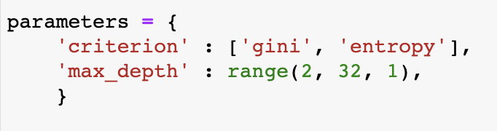
1. Select parameters and their ranges
From documentation and previous examples we already know some of the hyperparameters: criterion and max_depth

Slide 22
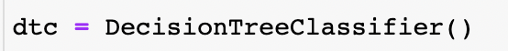
2. Choose our model

Slide 23
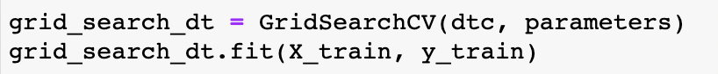
2. Choose our model
3. Create GridSearchCV variable passing values to it
4. Fit the data into GridSearchCV

Slide 24
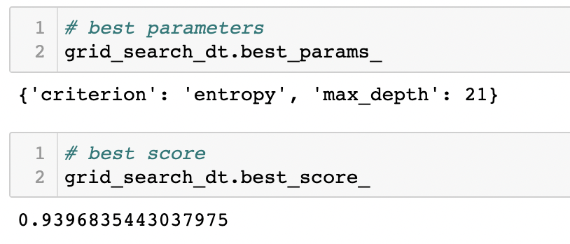
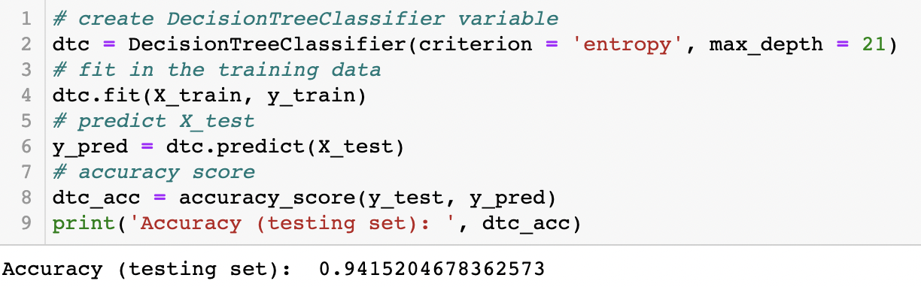
5. Find best parameters and results
6. Fit it to your model

Slide 25
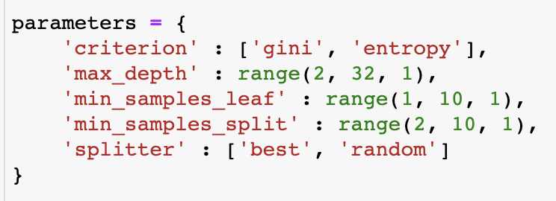
Your task for today will be to tune your model using the Grid Search method with next hyperparameters:
Compare accuracy results without tuning and with tuning

Slide 26
Reference
https://riskspan.com/tuning-machine-learning-models/#:~:text=Tuning%20is%20the%20process%20of,of%20a%20machine%20learning%20model
https://www.kaggle.com/code/willkoehrsen/intro-to-model-tuning-grid-and-random-search/notebook

